Slide 1
Oxidation Reactions

Slide 2
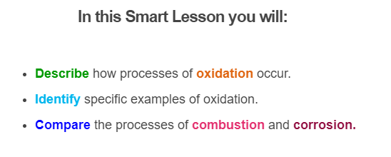
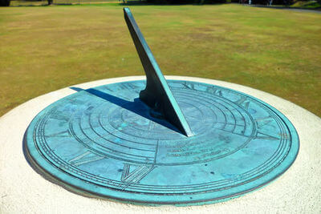
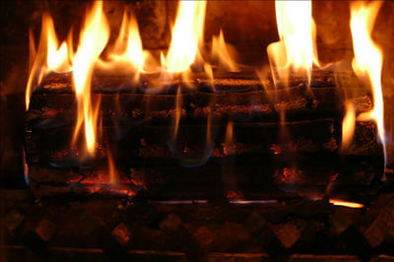

Slide 3
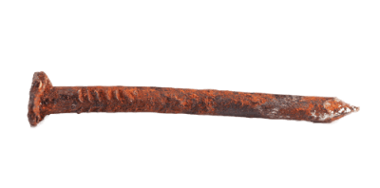
Combustion reactions are just one form of a reaction called oxidation.
Oxidation is a reaction where electrons are moved from one reactant to another.
Often this happens with the addition of oxygen to a metal.
For example, iron is oxidised when it rusts, because oxygen is added to the iron.

Slide 4
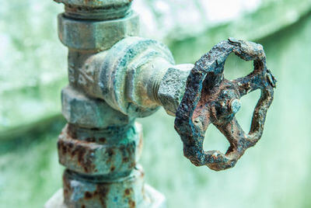
Combustion is the most notable form of oxidation, as the burning of a fuel will oxidise the fuel as oxygen reacts with it.
Corrosion is another common oxidation reaction, where metals react with water and/or oxygen to create oxides and hydroxides.

Slide 5
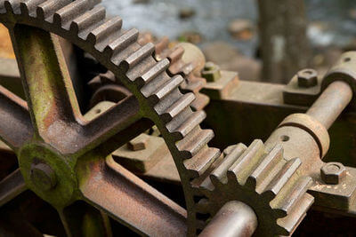
You've probably noticed that metal turns different colours and becomes thinner and weaker as it ages. This is a process called corrosion.
Corrosion oxidises a metal by reaction with the air and water. Many metals are slowly replaced by metal oxides over time, creating rusts, tarnishes and verdigris.

Slide 6
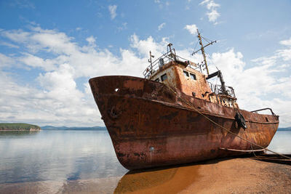
The most well known corrosion reaction is rusting, which refers exclusively to the corrosion of iron.
Rust is an orange flaky coating which develops on iron and steel over time. The iron reacts with oxygen in the air.
The process is also sped up by the presence of water and salt - this is why metal by the sea can rust very quickly.

Slide 7
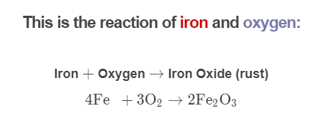
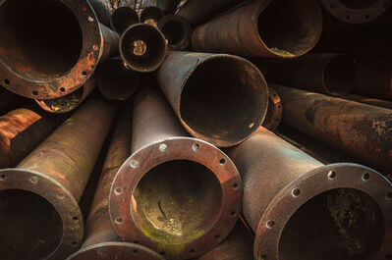
Iron oxide comes away from the metal easily, so fresh iron is continually exposed to make more rust. This slowly corrodes away the iron.

Slide 8

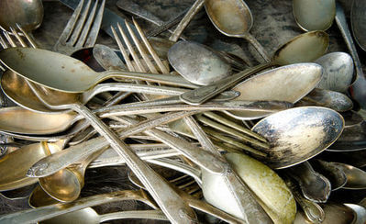
We have different names for the oxidations of other metals.
Silver has an oxidation reaction with hydrogen sulfide (H_{2​}S) which creates a black coating called tarnish.
Hydrogen sulfide comes from air pollution and some smelly foods such as eggs and onions.

Slide 9
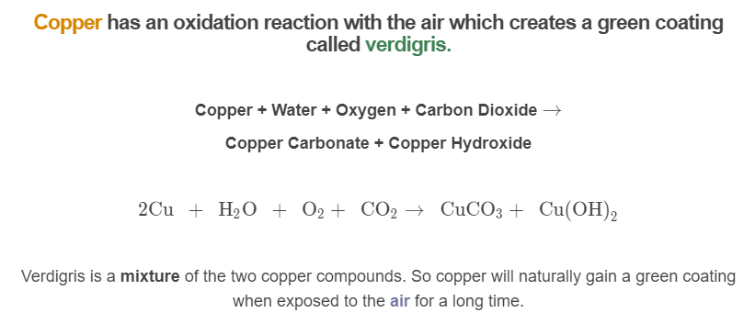
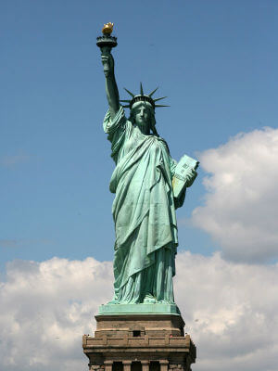

Slide 10
